Slide 1



CHM 103: Organic Chemistry I
Presented by:
Assoc Prof Okoli BJ MRSC, MACS
Department of Chemical Science,
Faculty of Science & Technology
Bingham University
The University with the difference
Bingham University

Slide 2
CHEMISTRY OF ALKENES
1. Physical properties of the alkenes
2. General Methods of Preparation of alkenes
3. Chemical Reactivity
Physical properties of the alkenes
i Physical state
Ethene, Propene, and Butene exists as colourless gases. Members of the 5 or more carbons are liquid, and members of the 15 carbons or more are solids.
ii Density
Alkenes are lighter than water and are insoluble in water due to their non-polar characteristics.
iii. Solubility
Alkenes are virtually insoluble in water, but dissolve in organic solvents.
Bingham University

Slide 3
Boiling Points
The boiling point of each alkene is very similar to that of the alkane with the same number of carbon atoms. Boiling points of alkenes depends on more molecular mass (chain length). The more intermolecular mass is added, the higher the boiling point.
Table 1: Meting Points and Boiling Points of common Alkenes
Compound | Melting Points (⁰C) | Boiling points (ºC)
Ethene | -169 | -104
Propene | -185 | -47
Trans-2-Butene |  | 0.9
Cis-2-butene |  | 3.7
Trans 1,2-dichlorobutene |  | 155
Cis 1,2-dichlorobutene |  | 152
1-Pentene | -165 | 30
Trans-2-Pentene | -135 | 36
Cis-2-Pentene | -180 | 37
1-Heptene | -119 | 115
3-Octene | -101.9 | 122
3-Nonene | -81.4 | 147
5-Decene | -66.3 | 170
Bingham University

Slide 4
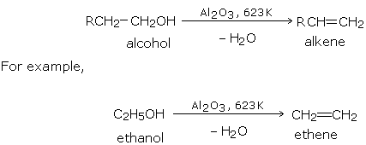
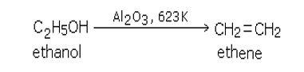
v. Melting Points
Melting points of alkenes depends on the packaging of the molecules. However, in cis isomers molecules are package in a U-bending shape, therefore, will display a lower melting points to that of the trans isomers.
General Methods of Preparation of alkenes
i. Dehydration of Alcohols
Alkenes are obtained by the dehydration of alcohols. The dehydration of alcohols can be effected by three common methods.
By passing the vapours of an alcohol over alumina (Al₂O₃) at 623 K (350°C).
The order of the ease of dehydration of alcohols is: tertiary > secondary > primary.
By heating an alcohol with concentrated sulfuric acid at 453 K (180°C).
Bingham University

Slide 5
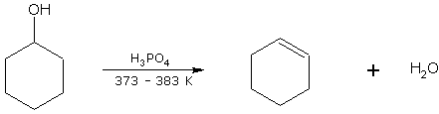
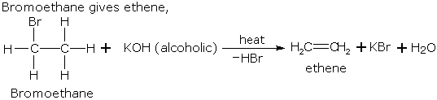
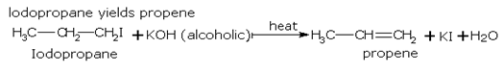
Anhydrous zinc chloride can also be used as a dehydrating agent.
Example: Cyclohexanol on dehydration gives cyclohexene.
cyclohexanol cyclohexene
ii. From haloalkanes (or, alkyl halides)
The haloalkanes are usually bromo- and iodo- and less commonly, chloro- derivatives.
1. By dehydrohalogenation of haloalkanes
Haloalkanes on heating with alcoholic potash loses one molecule of hydrogen halide to give alkene
Bingham University

Slide 6
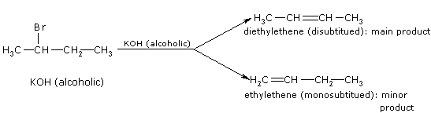
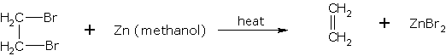
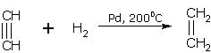
If two alkenes may be formed due to dehydrohalogenation of a haloalkane, the one which is most substituted is the main product.
Example : Dehydrohalogenation of 2-bromobutane gives,
The order of reactivity of haloalkanes in dehydrohalogenation is, Tertiary > Secondary > Primary.
2. From vicinal dihaloalkanes
Alkenes can be obtained from vicinal dihaloalkanes by dehalogenation. When such a dihaloalkane is heated with zinc in methanol. Example: 1,2-dibromoethane gives 1,2-dibromoethane ethene
iii. Hydrogenation of Alkynes
An alkyne on controlled hydrogenation with hydrogen in the presence of Ni or Pd at 200°C give a corresponding alkene. Example : Ethyne gives ethene on hydrogenation.
Bingham University

Slide 7
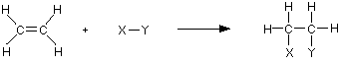
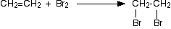
Chemical Reactivity
Alkenes undergo addition reactions. The rather exposed electrons in the pi bond are particularly open to attack by electrophiles. Most reactions of alkenes involve additions to this π bond, forming new single bonds.
a. Catalytic Hydrogenation of Alkenes
Although the hydrogenation of an alkene is a thermodynamically favourable reaction, it will not proceed without the addition of a catalyst(Pd-C, PtO2, and Ra-Ni).
b. Electrophilic Addition of Halogens to Alkenes
The reaction of the carbon-carbon double bond in alkenes such as ethene with halogens such as chlorine, bromine and iodine. This is called halogenation.
Simple reactions involving halogens
For example, bromine adds to give 1,2 dibromoethane.
Bingham University

Slide 8
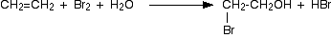
Alkenes and bromine water (Using bromine water as a test for alkenes)
Alkenes decolourise bromine water.
The chemistry of the test
This is complicated by the fact that the major product isn't 1,2-dibromoethane. The water also gets involved in the reaction, and most of the product is 2-bromoethanol.
However, there will still be some 1,2-dibromoethane formed, so at this sort of level you can probably get away with quoting the simpler equation:
Electrophilic Addition of Hydrogen Halides
The addition of hydrogen halides is one of the easiest electrophilic addition reactions. Hydrogen halides provide both a electrophile (proton) and a nucleophile (halide). All of the halides (HBr, HCl, HI, HF) can participate in this reaction and add on in the same manner.
Regiochemistry
The regiochemistry of this reaction can be explained through Markovnikov's Rule. The basics of this rule states that the proton will add to the less substituted carbon and the halogen goes to the more substituted carbon.
Bingham University

Slide 9
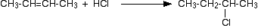
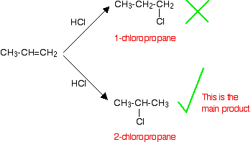
Addition to symmetrical alkenes
For example, with ethene and hydrogen chloride, you get chloroethane:
With but-2-ene you get 2-chlorobutane:
Addition to unsymmetrical alkenes
The problem comes with the orientation of the addition - in other words, which way around the hydrogen and the halogen add across the double bond.
Orientation of addition
If HCl adds to an unsymmetrical alkene like propene, there are two possible ways it could add. However, in practice, there is only one major product.
Bingham University

Slide 10
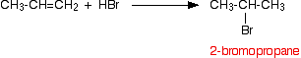
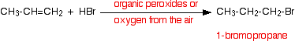
A special problem with hydrogen bromide
Unlike the other hydrogen halides, hydrogen bromide can add to a carbon-carbon double bond either way around - depending on the conditions of the reaction.
If the hydrogen bromide and alkene are entirely pure
In this case, the hydrogen bromide adds on according to Markovnikov's Rule. For example, with propene you would get 2-bromopropane.
That is exactly the same as the way the other hydrogen halides add.
If the hydrogen bromide and alkene contain traces of organic peroxides
Oxygen from the air tends to react slowly with alkenes to produce some organic peroxides. This is therefore the reaction that you will tend to get unless you take care to exclude all air from the system.
In this case, the addition is the other way around, and you get 1-bromopropane:
This is sometimes described as an anti-Markovnikov addition or as the peroxide effect.
Organic peroxides are excellent sources of free radicals. This reaction can also happen in this way in the presence of ultra-violet light of the right wavelength to break the hydrogen-bromine bond into hydrogen and bromine free radicals.
Bingham University

Slide 11
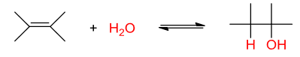
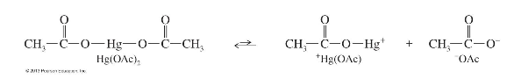
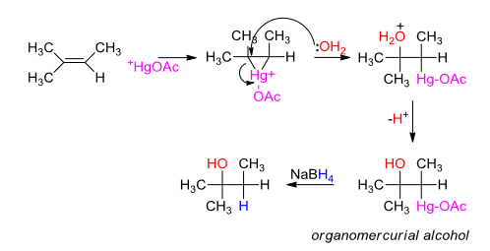
d. Hydration of Alkenes
Alkenes can be converted to alcohols. It is the reverse reaction of the dehydration of alcohols to give alkenes.
e. Oxymercuration-Demercuration
This is another alternative for converting alkenes to alcohols with Markovnikov orientation.
The reagent is called mercuric acetate (Hg(OAc)2). In solution it ionizes into acetate ion and positively charged mercury species which is very electrophilic.
When water is present, the nucleophilic oxygen will open the mercurinium ring, and generate an organomercurial alcohol.
Bingham University

Slide 12
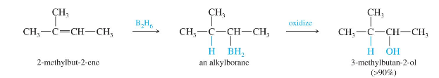
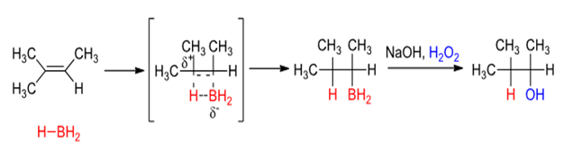
Demercuration is the removal of the mercury containing species, which is achieved by reaction with Sodium borohydride, which replaces the mercury species with a hydrogen atom –giving the desired alcohol.
f. Hydroboration Oxidation
There is a way to obtain anti-Markovnikov oriented alcohols: hydroboration. Borane adds to alkenes with anti-Markovnikov orientation, and these alkylboranes can then be oxidized to alcohols.
Mechanism of Hydroboration
The boron atom adds to the least highly substituted end of the double bond. This places partial positive charge on the more highly substituted end of the double bond (which is more stable). Hydroboration also gives syn addition of the boron and hydrogen (and therefore the –OH and –H). This is a stereospecific reaction.
Bingham University

Slide 13
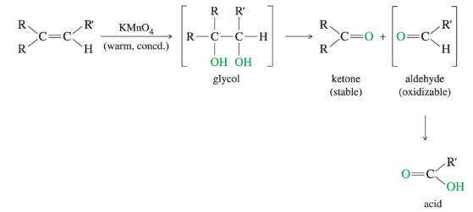
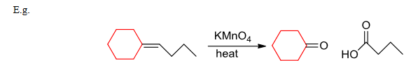
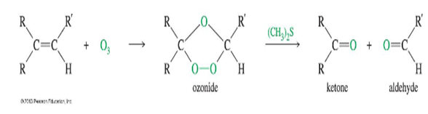
2. Oxidative Cleavage
a. Oxidation of alkenes with cold dilute potassium manganate(VII) solution
If either acid or heat is used with permanganate, cleavage and further oxidation can occur producing ketones and/or aldehydes. The aldehydes further oxidize to carboxylic acids.
b. Ozonolysis
Ozone (O3) also cleaves double bonds, but this milder reagent gives aldehyde and ketones as the products. The intermediate ozonide reacts with reducing agents like dimethyl sulphide to produce DMSO and the carbonyl products.
Bingham University

Slide 14
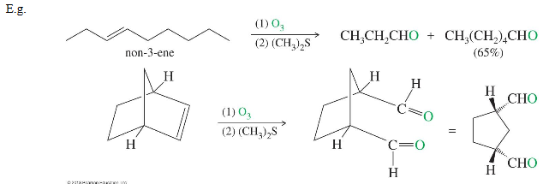
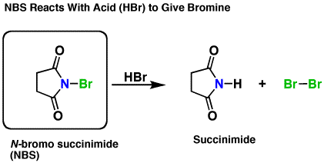
Ozone reacts with the double bond to give an unstable molozonide (primary ozonide) which rearranges to an ozonide. This cleavage reaction is often used to identify the positions of double bonds in alkenes.
3. Allylic Substitution
If the bromonium ion source N-bromosuccinimide (NBS) is present with a trace amount of acid (HBr), HBr will react with NBS to give succinimide and Br2.**
Since one equivalent of HBr generates one equivalent of Br2, This keeps the concentration of Br2 low and allows the free-radical reaction to out-compete the alkene addition reaction.
Bingham University

Slide 15
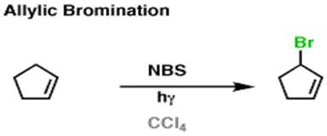
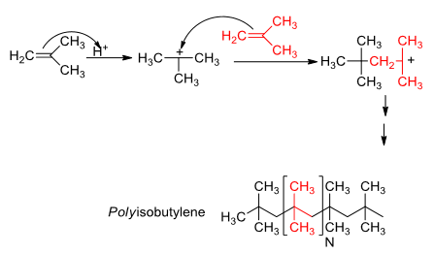
4. Polymerization of Alkenes
Alkenes in the presence of strong acids can be made to polymerize. An electrophile (H+) adds electrophilically to the double bond, and the carbocation is attacked by another alkene double bond.
Bingham University

